Slide 1

Wildfire Prediction Using Satellite Imagery
A Deep Learning Approach to Wildfire Detection
Presenter Names
Fnu Mohammed Abdul Wali Farooqui
Boluwatife Olumide Blessing Alagba
Vinu Preetham Bandi
Wichita state University, Wichita, USA.

Slide 2
Presentation Outline
Introduction: Overview of wildfires and Machine Learning
Objectives: Goals of the project
Related work: Existing research context
Methodology: Data and model approach
Results: Performance metrics
Conclusions: Key findings and implications
References: Sources cited

Slide 3
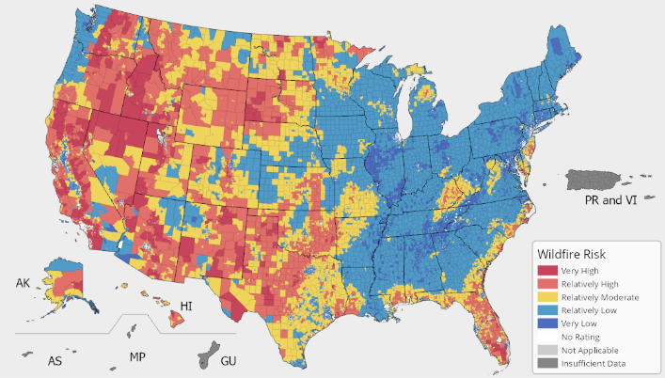
Introduction
Wildfires pose significant environmental and economic threats globally. Example: The California wildfires of 2020 burned over 4.2 million acres, highlighting the need for early detection.
Satellite imagery offers a scalable way to monitor and predict wildfire risks.
Machine Learning, especially deep learning, can analyze vast image data effectively.
Project focus: Detect wildfires using satellite imagery with CNN-based model.

Slide 4
Objectives
Develop a deep learning model to detect wildfires from satellite images.
Improve prediction accuracy for wildfire-prone areas (target >90%) in wildfire detection.
Evaluate model performance using precision, recall and F1-score.
Lay groundwork for real-time wildfire monitoring systems.
Notes:
Developing an AI-based model that can accurately classify satellite images as wildfire or non-wildfire.
Enhancing prediction accuracy using deep learning techniques like Convolutional Neural Networks (CNNs).
Supporting emergency response teams by integrating real-time satellite image analysis for quick decision-making.
Example: NASA’s Fire Information for Resource Management System (FIRMS) provides real-time fire alerts, helping authorities respond faster.

Slide 5
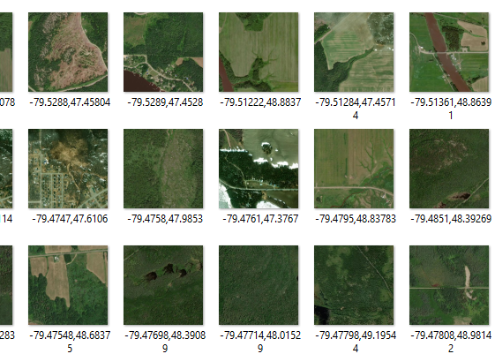
Dataset
In the research paper they where using 375 X 750px
But we are using 42,850 image of 350x350px
If from Kaggle

Slide 6
Related Work
Traditional wildfire detection methods rely on ground reports and meteorological data.
Satellite-based monitoring allows for large-scale coverage but requires AI for efficient analysis
Previous AI models such as CNNs have shown success in wildfire detection. Example: Google’s AI-powered wildfire detection system uses satellite images to track fires and alert authorities.
Notes:
Traditional wildfire detection methods rely on meteorological data, such as temperature, humidity, and wind speed, which often lack real-time accuracy.
Satellite-based monitoring provides large-scale coverage but requires AI-driven models to analyze vast amounts of image data efficiently.
Deep learning models like CNNs have shown remarkable success in classifying images, making them an ideal choice for wildfire detection.
Example: Google’s AI-powered wildfire detection system uses satellite images to track fires and send alerts, reducing disaster response times.

Slide 7
Methodology
Dataset: Wildfire and non-wildfire satellite images collected from NASA and MapBox.
Image Processing: Images resized to 350x350px, normalized, and augmented for better model training.
Model Architecture: A convolutional neural network (CNN) trained on labeled wildfire and non-wildfire images.
Training & Evaluation: Model trained using TensorFlow and tested on a separate dataset. Example: A dataset containing 22,710 wildfire images and 20,140 non-wildfire images was used for model training.
Notes:
Face detection(AdaBoost classifier) and extraction of facial landmarks(68) were done using the face-alignment method available in PyTorch package.

Slide 8
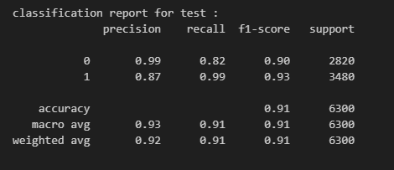
Results
Model achieved 91% accuracy on test data, indicating strong performance
Classification report: - Precision: 99% (Non-wildfire), 87% (Wildfire) - Recall: 82% (Non-wildfire), 99% (Wildfire) - F1-Score: 90% (Non-wildfire), 93% (Wildfire) Example: The model correctly classified 6,300 test samples with a high accuracy rate.
Notes:
The trained model demonstrated high accuracy and reliability in wildfire classification:
Overall Accuracy: 91%
Classification Metrics:
Precision: 99% (Non-wildfire), 87% (Wildfire)
Recall: 82% (Non-wildfire), 99% (Wildfire)
F1-Score: 90% (Non-wildfire), 93% (Wildfire)
Key Findings:
The model effectively distinguishes between wildfire and non-wildfire images.
High recall for wildfire cases ensures fewer false negatives, making it suitable for real-time deployment.
Minor misclassifications in smoke-covered areas indicate potential areas for improvement.
Example: The model correctly classified 6,300 test samples, proving its effectiveness in large-scale wildfire detection.

Slide 9
Conclusions
AI-driven wildfire detection using satellite imagery is a game-changer in disaster management.
The model’s high accuracy makes it a reliable tool for real-time wildfire monitoring and prediction.
Future improvements include:
Deploying the model on cloud platforms for real-time inference.
Expanding the dataset with additional wildfire conditions (smoke, different terrains).
Integrating the system with drones and IoT sensors for enhanced wildfire tracking.

Slide 10
References
Dataset
Wildfire Prediction Dataset (Satellite Images)
Research papers
https://ieeexplore.ieee.org/document/9067475
https://ieeexplore.ieee.org/document/9554904
https://ieeexplore.ieee.org/document/10465865
Existing Systems
NASA FIRMS (Fire Information for Resource Management System)
Canada's Wildfire Information System (CWIS)
Some Sites from Which Data Taken
NASA,WORLDVIEW

Slide 11
Thank You!

